Slide 1
Speech Analysis TA : 盧宏宗
HW 2-2
2015/04/08

Slide 2
Goal
This homework is aimed to analyze speech from spectrogram, and try to distinguish different initials/ finals on spectrogram.

Slide 3
Before you start, you should know…
…about the initials/finals (聲母/韻母) in Mandarin Chinese.
…about Right-Context-Dependent Initial Final (RCDIF)
Ex: t_a stands for ㄊ followed by finals starting with ㄚ-like sounds, like ㄊㄞ= t_a ai

Slide 4
Before you start, you should know…
…about some classification of consonants
Plosive/Stop (爆破音/塞音) ㄅㄆㄉㄊㄍㄎ
Fricative (擦音) ㄈㄏㄒㄕㄙ
Affricate (塞擦音) ㄐㄑㄓㄔㄗㄘ
Nasal (鼻音) ㄇㄋ
…about some classification of vowels
Monophthong (單母音) ㄧㄨㄩㄚㄛㄜㄦ
Diphthong (雙母音) ㄞㄟㄠㄡ……

Slide 5
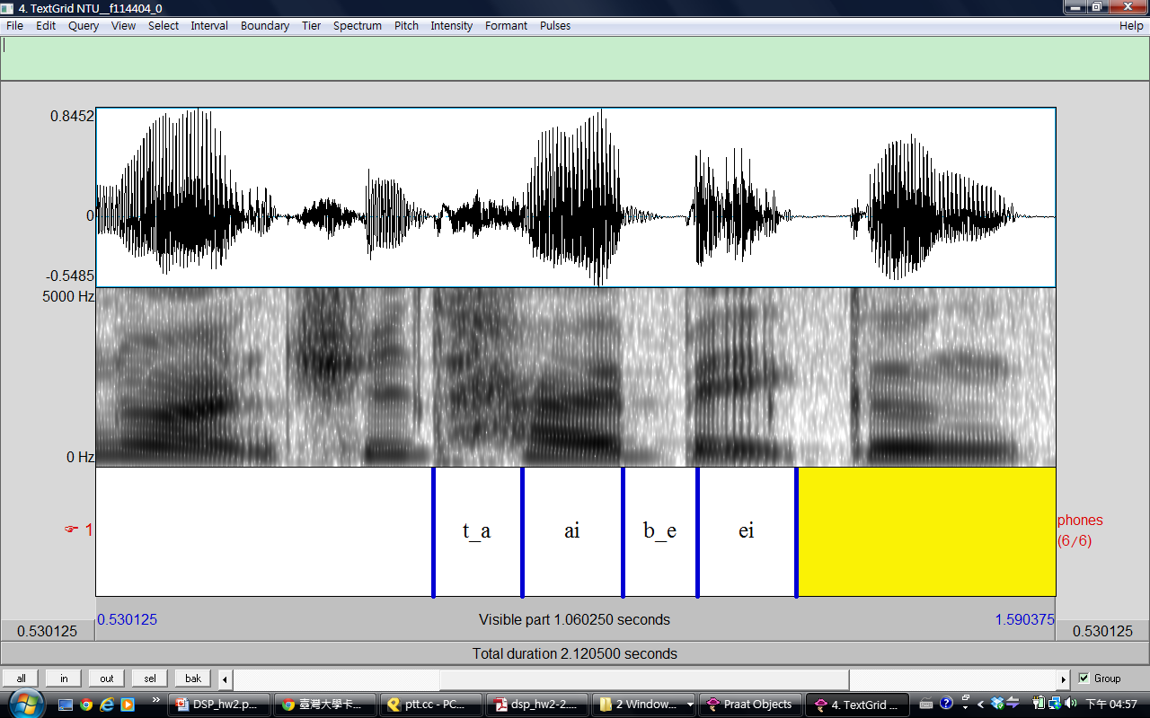
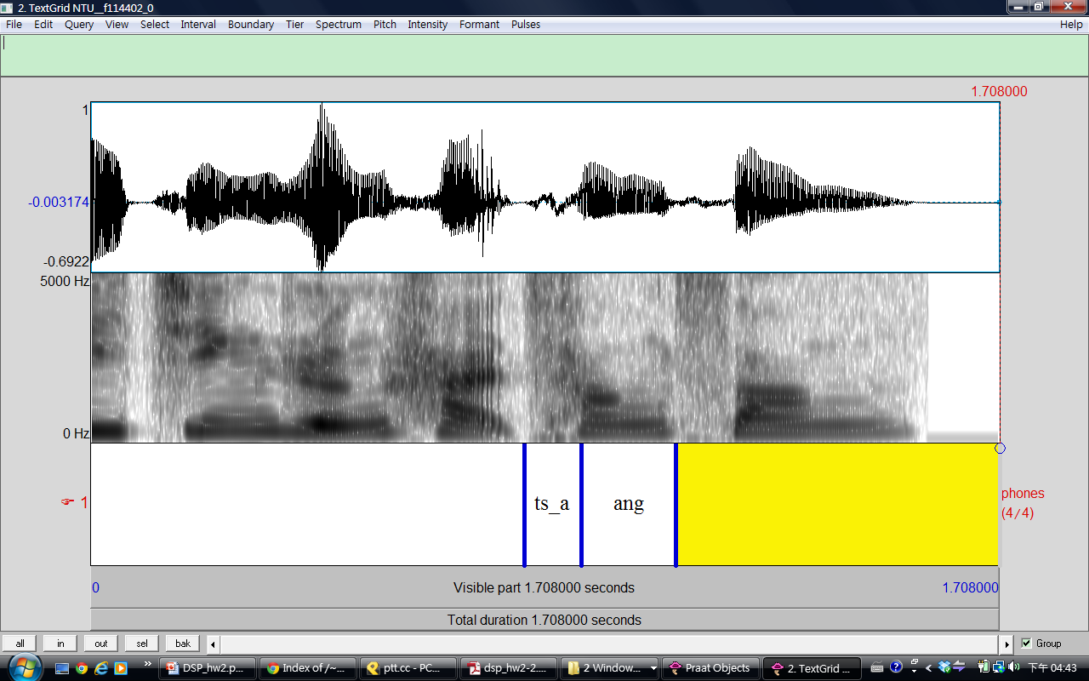

Before you start, you should know…
…how labeling works
“sil” for silence
“sp” for short pause
fricative/affricate
(擦音/塞擦音) initials do not contain voicing parts
plosive (爆破音)
initials contain closure or aspiration period

Slide 6
Some files you need
Phonetic class table (聲韻母表):
http://speech.ee.ntu.edu.tw/homework/DSP_HW2-2/phonetic_class.pdf
Syllable table (標註模式):
http://speech.ee.ntu.edu.tw/homework/DSP_HW2-2/syllable.txt
Audio data & FAQ:
check out http://speech.ee.ntu.edu.tw/homework/DSP_HW2-2/

Slide 7
Tools for labeling
Wavesurfer
MATLAB
Praat
we will be using this for hw2-2

Slide 8
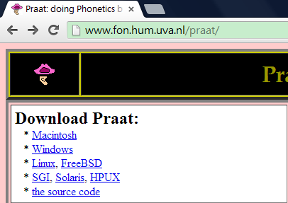
Praat
Download
http://www.fon.hum.uva.nl/praat/

Slide 9
Praat

Slide 10
Praat
Read from file (.wav file from data)

Slide 11
Praat
View & Edit

Slide 12
Praat

Slide 13
Pitch

Slide 14
Intensity

Slide 15
Formant

Slide 16
Reminder
The intensity is the power of all frequency components. The acoustic signal may contain the same amount of power but in quite different frequency components.
The formant is an acoustic resonance, measured by the peak in the frequency spectrum. You should not trust the formant detection output for unvoiced initials.

Slide 17
Praat
Annotate to TextGrid

Slide 18
Praat
Create one interval tier named RCDIF
No point tiers

Slide 19
Praat
View & Edit with both objects selected

Slide 20
Praat

Slide 21
Labeling
Click on spectrogram for your boundary
Add the boundary by clicking the small circle
Remove by choosing “Boundary/Remove”
Drag your boundaries to be more accurate
Click between your boundary and type in your label (according to the “Syllable table”)
Listen to your label by clicking the number (interval time) below it

Slide 22
Praat

Slide 23
Praat
After finish labeling
Save your TextGrid object as short text file
File should be “.TextGrid” not “.Collection”

Slide 24
Part 1 (20%)
Choose your wave files from directories according to your student ID.
You must submit at least 5 fully labeled TextGrid files (along with their wave files)
These 5 files should contain the initial/final labels you use in part 2

Slide 25
Part 2 (30%)
Choose at least 2 initials from the 4 classes (Plosive, Fricative, Affricate, Nasal)
For each of these 8 initials, create a table that contains at least 2 screenshots of its label (please show intensity and formant)
An example of a table for plosives ㄅ & ㄆ is on the next two pages

Slide 26
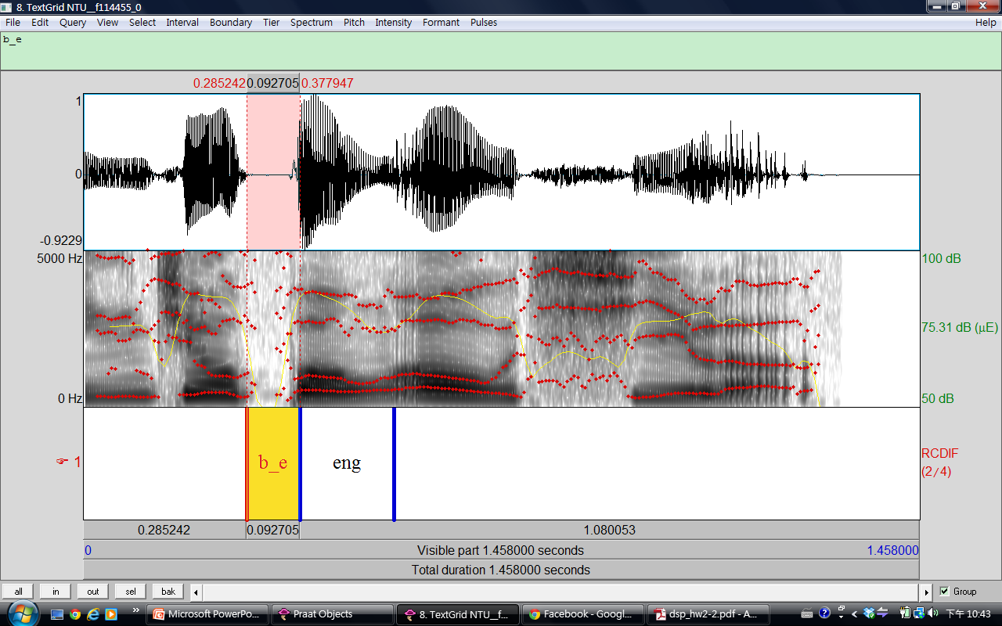
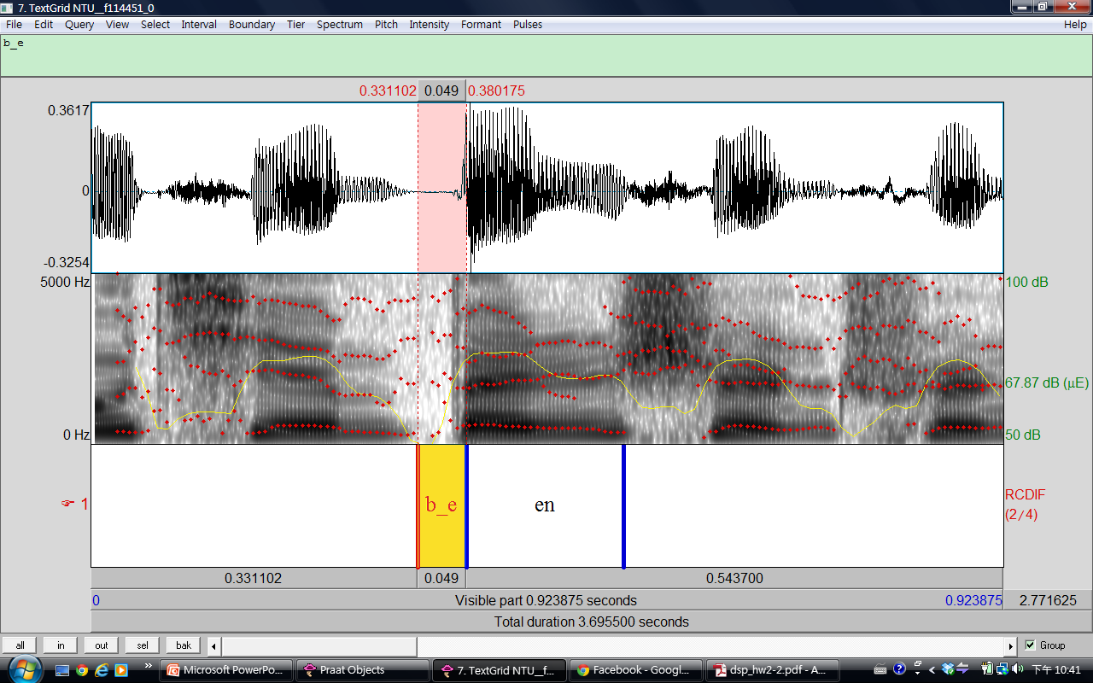
Part 2 (30%)
Phonetic Class
Plosive | b(ㄅ)

Slide 27
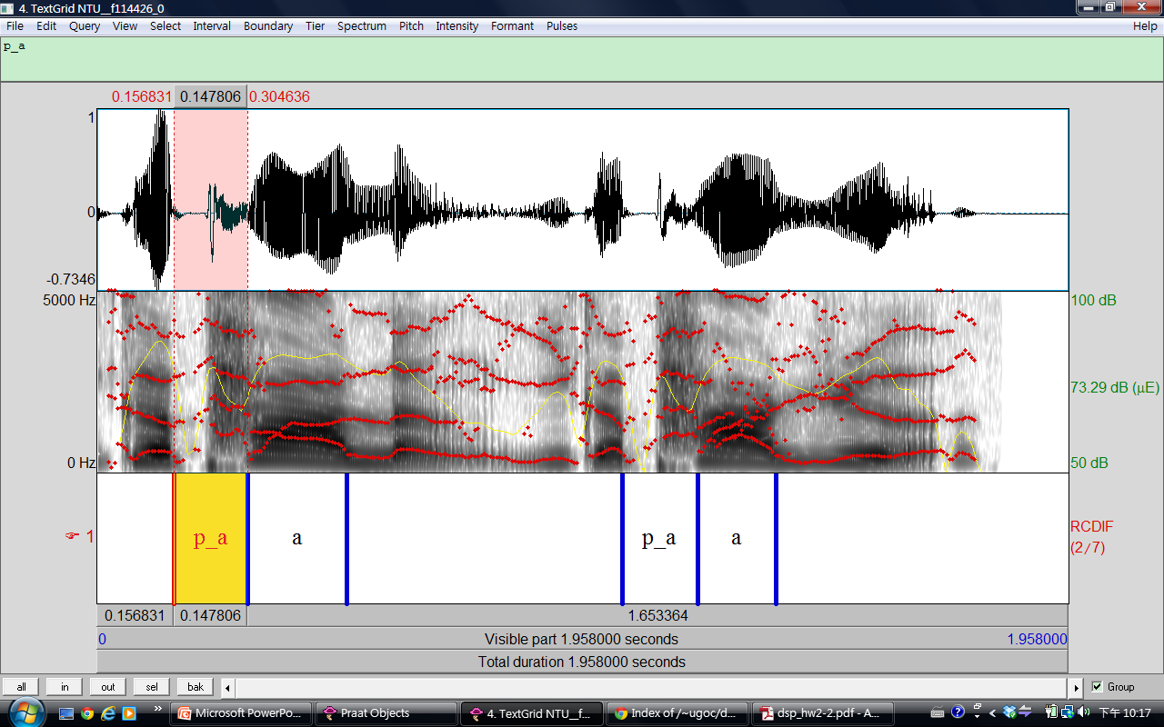
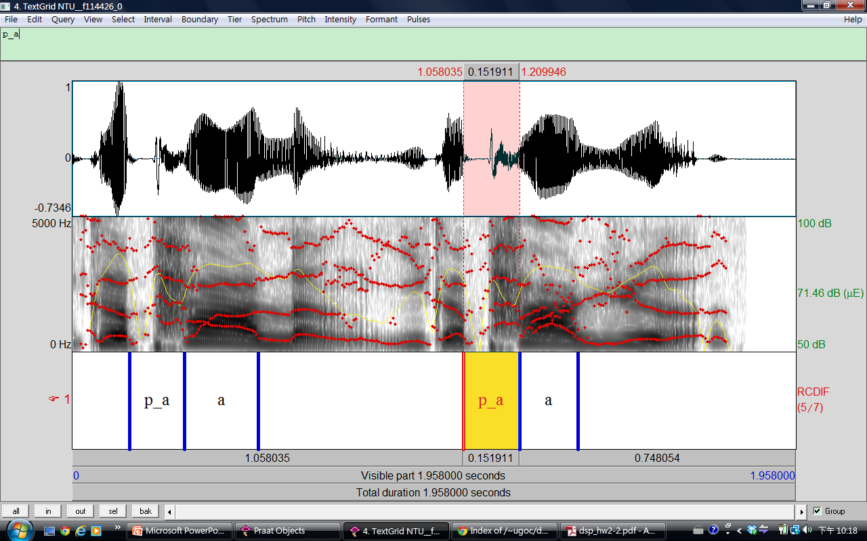
Part 2 (30%)
Phonetic Class
Plosive | p(ㄆ)

Slide 28
Useful tips
Zoom in & out, show all or selection part in Praat by clicking the buttons on the lower-left corner of spectrograms
In your chosen directory
“NTU_XXXXX_phn2file” lists all files containing each phone
“NTU_XXXXX_file2phn” lists all phones contained in each file

Slide 29
Part 3 (50%)
(20%) What are the consistencies of the spectrogram in each phonetic class? (Plosive, Fricative, Affricate, Nasal)
(10%) Is the boundary between neighboring initial and final clear? What is the benefit of using “right-context dependent” initial model (ex: sh_a) instead of pure initial model (ex: sh) to model initials?

Slide 30
Part 3 (50%)
(10%) What are the differences when pronouncing ㄅ & ㄆ? How can you tell the differences in spectrogram for ㄅ & ㄆ? (You may also want to compare ㄉ & ㄊ, ㄍ & ㄎ respectively)
(10%) Take a look at the spectrogram of finals. Is there any simple rules to discriminate initials from finals provided only spectrogram?

Slide 31
Bonus (10%)
The following is a speech analysis plot for a Chinese word composed of 3 characters. Each character is composed of an initial and a final.
Guess what the word is and describe your reasoning. (Score: reasoning 8%, correct answer 2%)
If you cannot figure out the word, you can guess the phonetic class or initial/finals. For example, your answer can be “l_i, i, sic_a, au” or “plosive, diphthong, plosive, monophthong”.

Slide 32
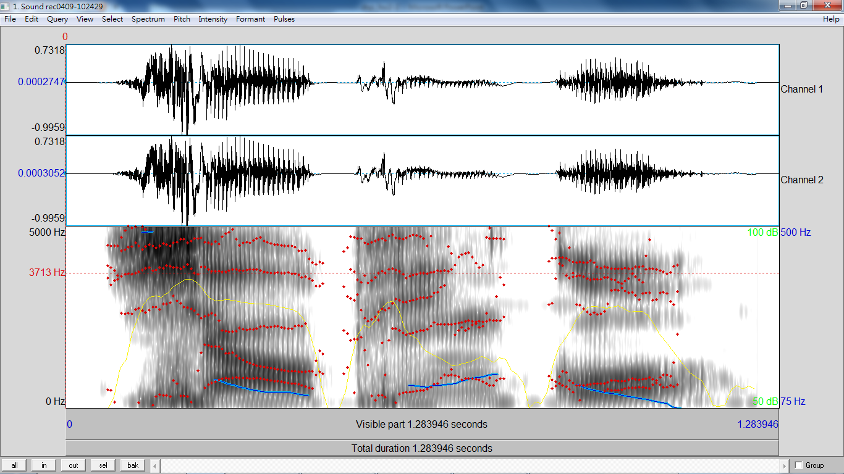
Hint: it’s a Chinese pop song in the last 2 years.

Slide 33
Submission Requirements
5 TextGrid files (each along with its wave file)
the “.TextGrid” & “.wav” filenames should be the same
1 report (in PDF format)
the filename should be hw2-2_bXXXXXXXX.pdf (your student ID)
Put those 11 files in a folder (named after your student ID), compress the folder to 1 zip file and upload it to ceiba
10% of the final score will be taken off for each day of late submission
Attention: there should be a student-ID-folder containing those 11 files in your zip file. Any wrong file format will get a penalty of points.

Slide 34
If you have any problem…
… look up the Praat introduction website.
It should solve all your technical problems.
http://www.fon.hum.uva.nl/praat/manual/Intro.html
…contact the TA by email. 盧宏宗 r03922011@ntu.edu.tw

Slide 35
Homework #2
Your can submit either
HW 2-1 (HMM Training and Testing)
HW 2-2 (Speech Analysis)
You can also submit both
The higher grade of the two will count as your final score for HW2
Deadline: To be discussed

Slide 36
Thank You
Questions?

